Slide 1
Programming training (2)
Chun-Yuan Lin

Slide 2
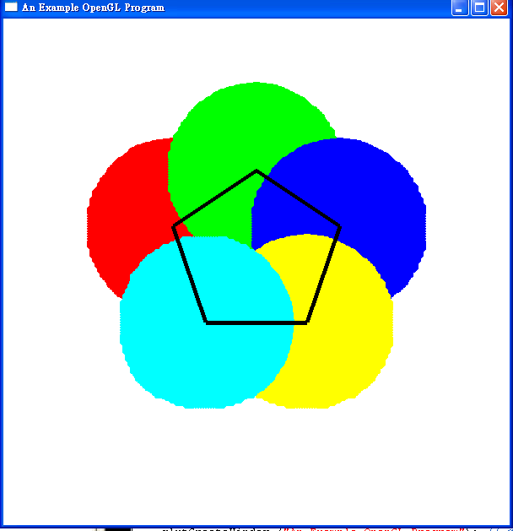
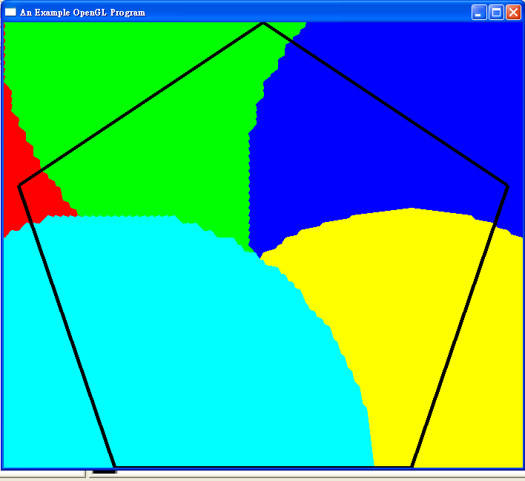

a.
b.
c.

Slide 3
Training 2
Please send the Source code (*.c or *.cpp) to me (cyulin@mail.cgu.edu.tw) before 10/21, 23:59:59.
Please annotate your name and your student ID in email.
  The file name is “student ID”. If more than one files, the names are “student ID-1”, “student ID-2”, etc.
  Please compress the file(s) to a .zip or .rar file. The file name is “student ID-train2”.
  For example, a student has ID “A0000001” and two source code files. The source code file names are A0000001-1.c and A0000001-2.c and the compressed file name is A0000001-train2.zip.
The files will be rejected without following the rules.

